Slide 1
Dropshipping

Slide 2
About me
Jafar Najafov
ASEU – Finance and Credit Coventry University – International Business
Founder and Director of JN Design Google & Microsoft Certificates Holder.
Got 350,000 app downloads with Hara Gedek Project
Got investment with 1 million $ valuation with Shrippy startup.
Right now, managing several e-commerce websites ;)

Slide 3
What is drop shipping ?
Drop shipping means you get someone else to
package and ship your products for you. Order from your website automatically gets packaged and shipped to your customer. It shows up to their door without you ever having to worry about it. Now you can focus on growing your business.

Slide 4
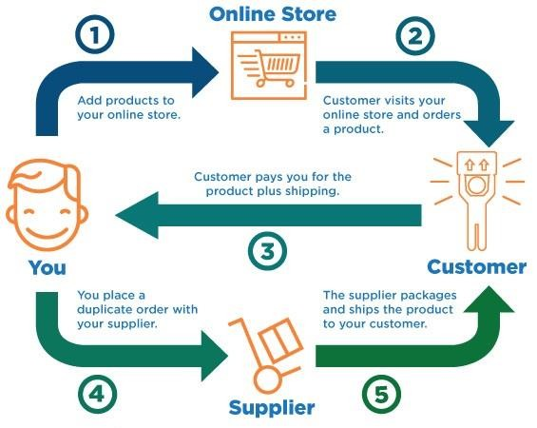
What is drop shipping ?

Slide 5
Dropshipping vs standard retail model
The biggest difference between dropshipping and the standard retail model is that the selling merchant doesn't stock or own inventory. Instead, the merchant purchases inventory as needed from a third party – usually a wholesaler or manufacturer
– to fulfill orders.

Slide 6
Advantages
Less Capital Is Required
Easy to get started
Flexible location
Wide selection of products
Easy to scale

Slide 7
Disadvantages
Low margins
Inventory issues
Shipping complexities
Supplier errors

Slide 8
How to find a supplier ?
There are lots of Chinese e-commerce websites which can do dropshipping for you. One of the famous one is Aliexpress.

Slide 9
Thank You!

